Slide 1
Project Zecharabra

Slide 2
Premise
Zechariah “Cara” is a jaded child who struggles to come to terms with her parents divorce.

Slide 3
She wakes up in a world without adults called “Forever Land”, where everything seems like it’s lively and full of cheer.

Slide 4
However the true side of Forever Land is reviled and Cara learns that children hearts are harvested in order to keep the world preserved.

Slide 5
Goal
Escape the from Forever Land.

Slide 6
Type: Top down puzzler, turn by turn, Role playing game, with table top game elements.
Theme: Alice and wonderland/carnival/Surrealist
Genre: Psychological/Horror/fantasy

Slide 7
Mechanics
Puzzler
Inventory
Equipment
Weapons
Items
Combat
Grid
turn by turn
spell building
melee
Dice rolling
Proficiency leveling

Slide 8
Flow
Dungeon crawling
Grinding/proficiency training
Puzzles
Spell building
Beating bosses

Slide 9

Style

Slide 10
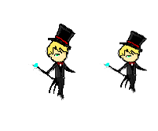
Concept Art

Slide 11
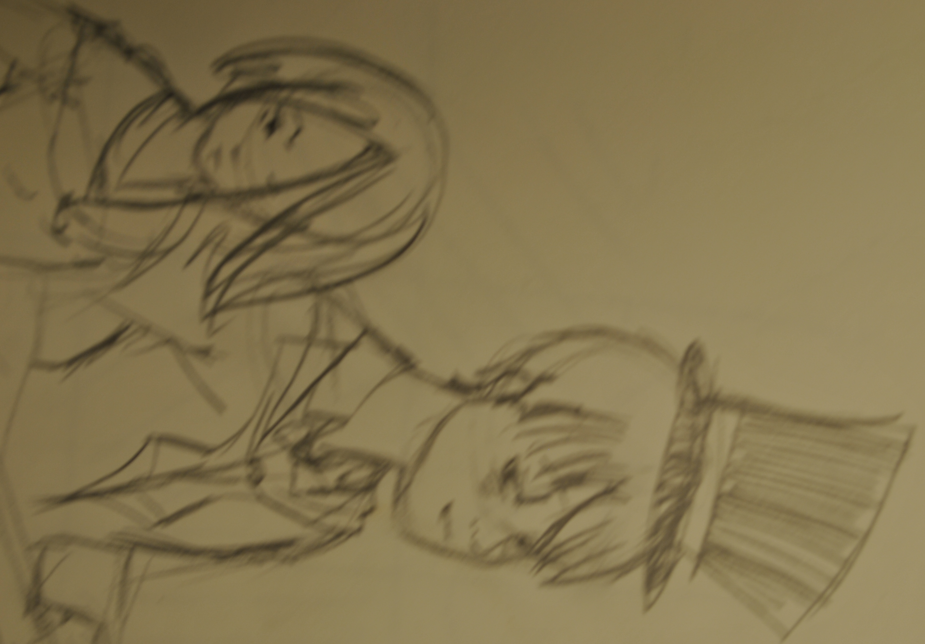

Slide 12
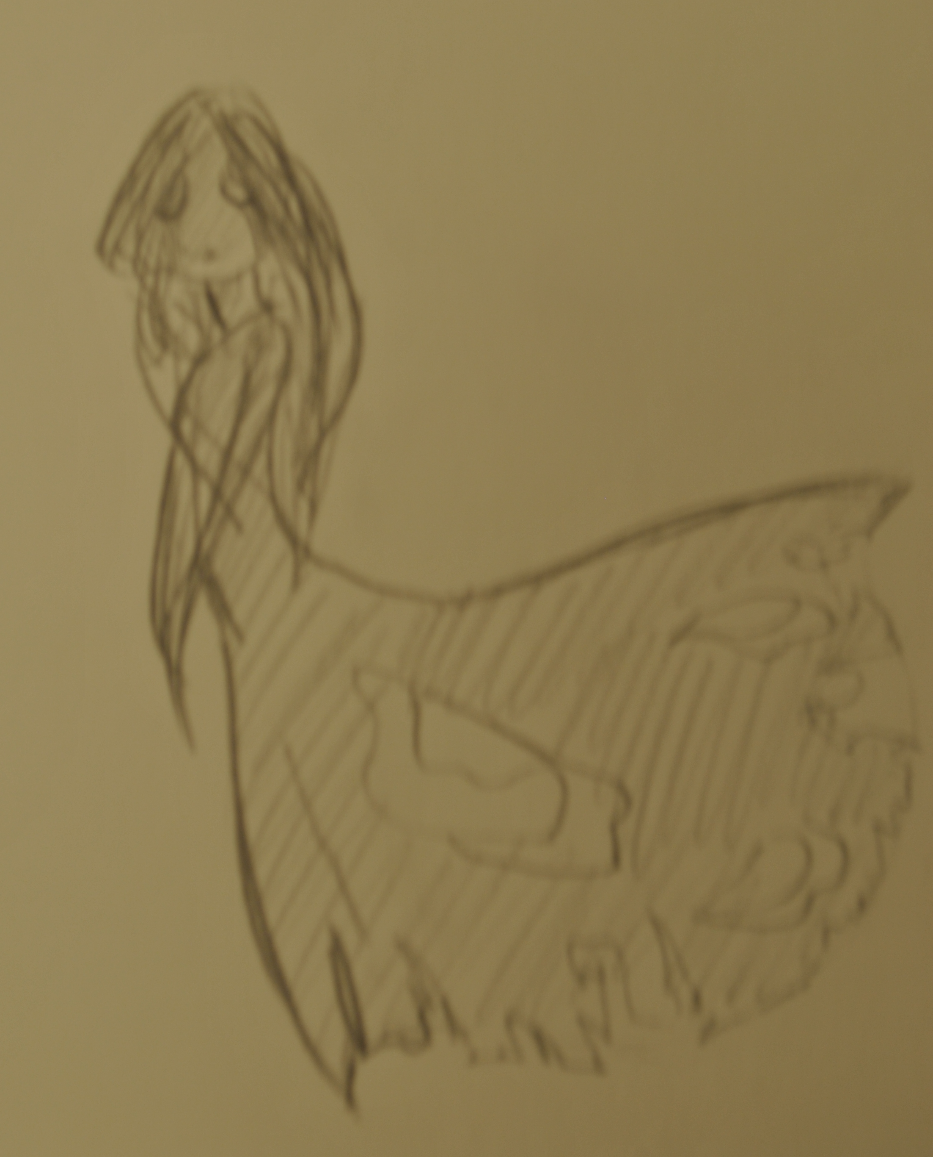
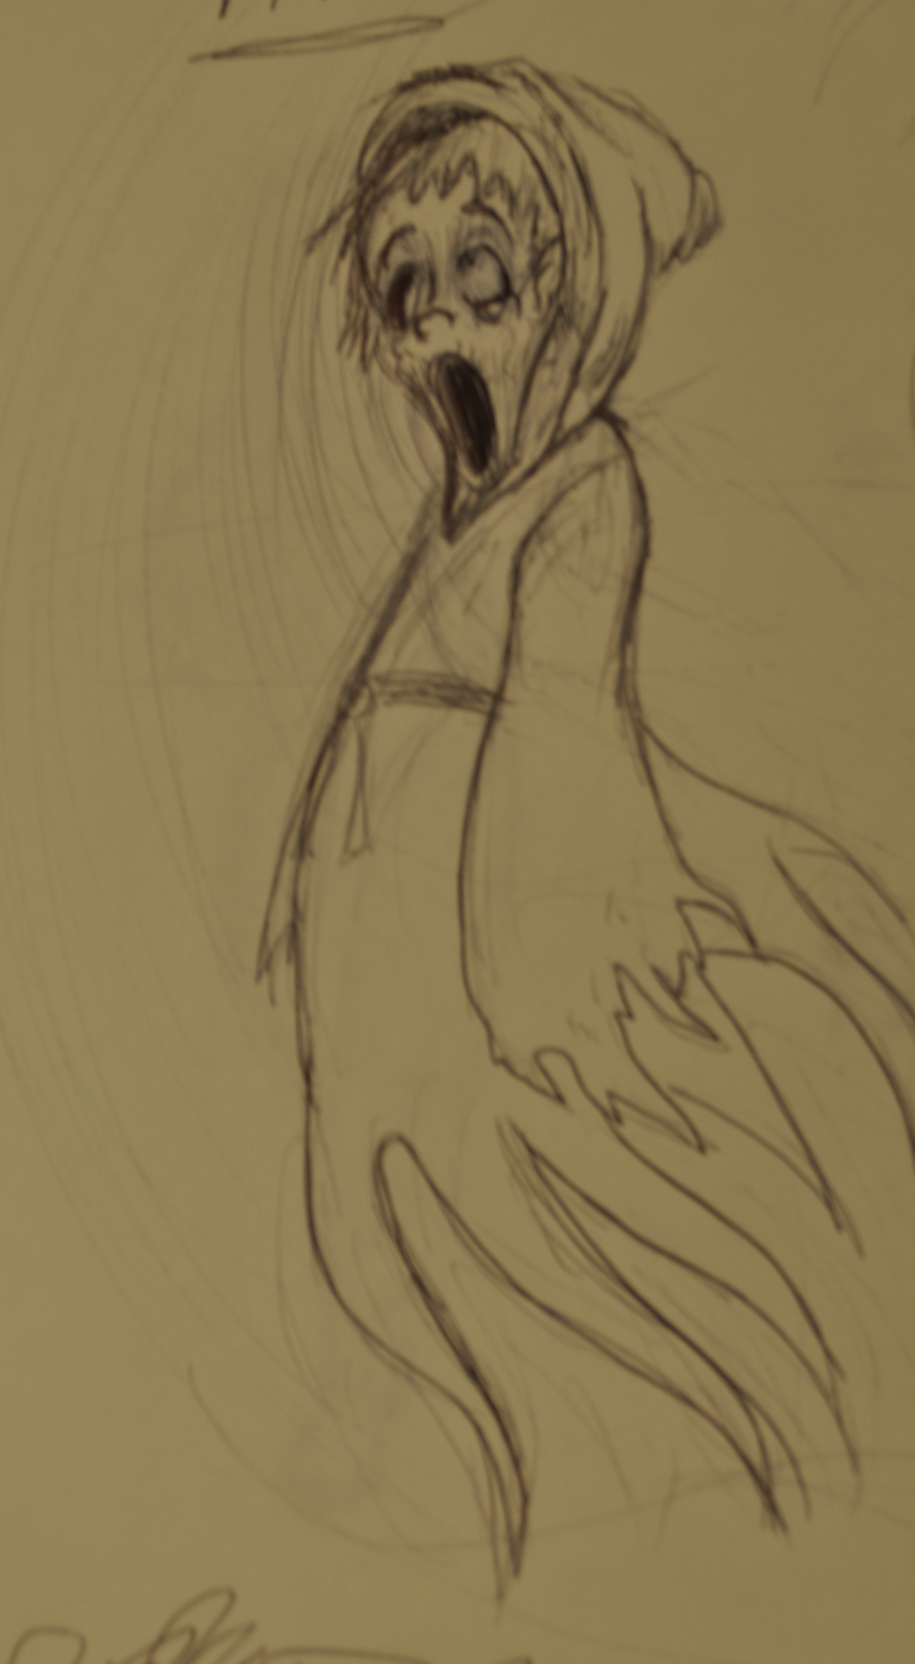

Slide 13



